Slide 1


Welcome to Reception at
Newlands Primary Academy

Slide 2
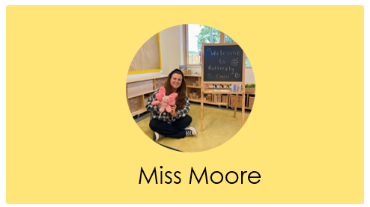
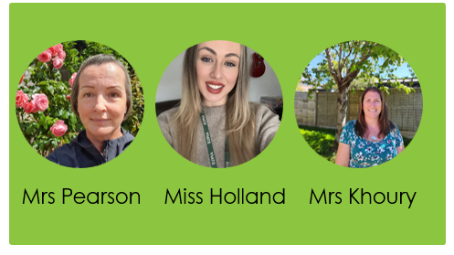

Meet the Reception staff
Butterflies Class Teacher
Teaching Assistants

Slide 3

Starting at Newlands
Inside your pack:
Important dates
Frequently asked questions
Tapestry letter
Summer Fair leaflet
School readiness leaflet
Vision and values
Name card
Long Term Plan
Timetable
Volunteer leaflet

Slide 4

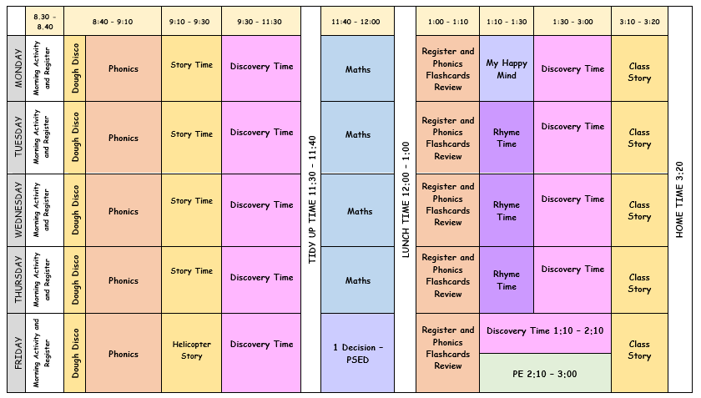
Butterflies Class
Timetable -
Children can arrive at school from 8:30am to 8:40am.
Children can be collected at 3:20pm.

Slide 5
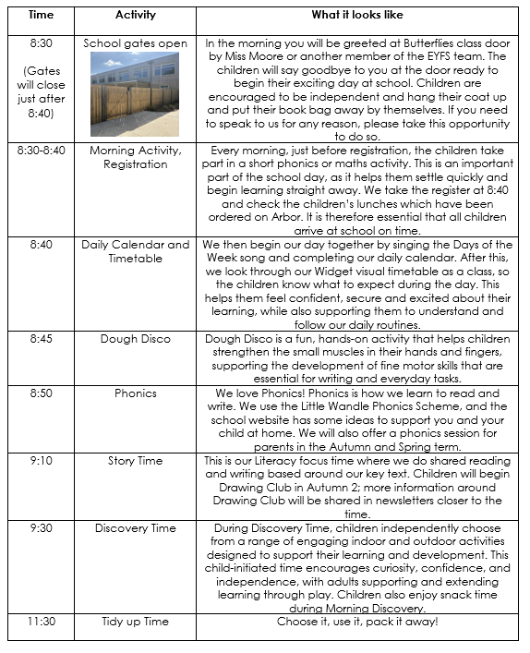
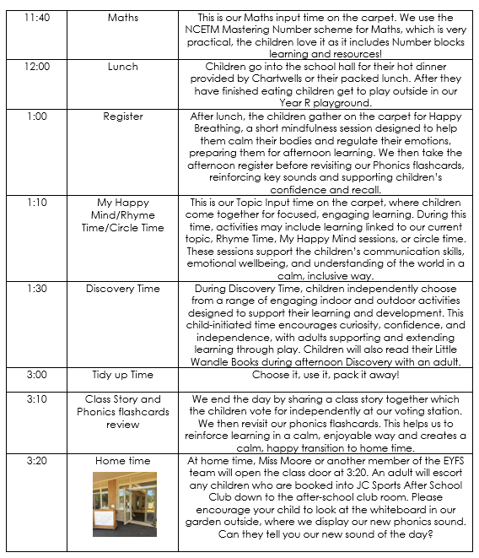
Daily Routine

Slide 6

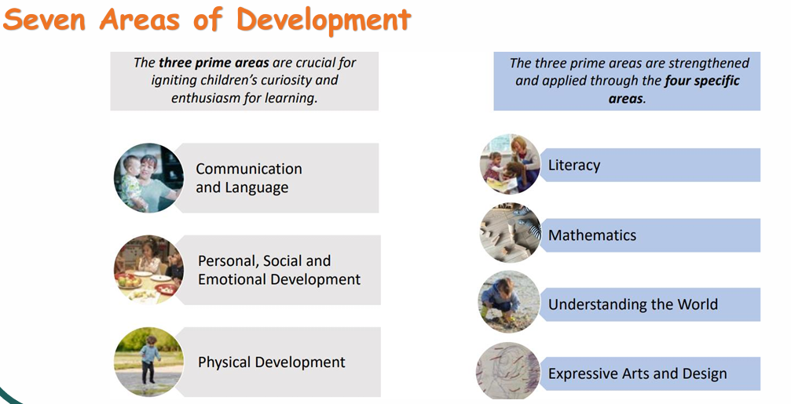
Early Years Framework

Slide 7
Early Years Framework
Baseline Assessment
In September 2017 the Department for Education announced that a new assessment in Reception would be introduced as a baseline measure to track pupils’ progress during primary school. Due to disruption, the first baseline took place in 2021. The Reception Baseline Assessment (RBA) has been developed in conjunction with the teaching profession, and will be 'teacher-mediated', meaning it will be administered by a teacher or teaching assistant.
The focus of the RBA will be on communication, language and literacy, and maths. It will take around 15 minutes.
The RBA data will be used to judge how much progress children have made by the end of KS2(Year 6). There will be no "pass" or "fail" or numerical score, and the results of the RBA will not be used to track individual pupils or to judge schools' Foundation Stage performance

Slide 8


Reading & Phonics
Children are taught to read by breaking down words into separate sounds (segmenting).
They are then taught how to blend these sounds together to read the whole word.
c-a-t cat d-o-g dog f-i-sh fish b-ear-d beard
NB. Tricky words cannot be sounded out. High frequency words are to be read by sight.
We use Little Wandle Phonics. More information can be found on their website:
https://www.littlewandle.org.uk/resources/for-parents/

Slide 9

Reading at home
The children will also come home every Friday with a Little Wandle book and a sharing book from their library. You will be given a log in to Boom Reader where you can record your child’s reading. We ask that you read/share a book with your children at least four times a week and record this on the Boom Reader app. More information will be provided during your children’s first few weeks at school. We give special Boom Reader certificates to celebrate reading at home.

Slide 10

Maths
MASTERING NUMBER
We use Mastering Number Programme from the National Centre for Excellence in the Teaching of Mathematics (NCETM). This initiative aims to develop strong foundational number sense in our Reception (Year R) students. Through engaging activities and focused teaching, your child will build fluency and confidence with numbers, setting them up for future success in mathematics.
The programme includes:
• Daily short sessions: Four times a week, designed to enhance number fluency and flexibility.
• Hands-on learning: Using manipulatives to understand mathematical concepts.
• Supportive community: Teachers receive ongoing training and share best practices to ensure every child thrives.

Slide 11

Maths
AT HOME
Engage in Daily Practice: Spend a few minutes each day on number activities. This could be counting objects around the house, playing number games, or using apps designed to improve number sense.
Use Everyday Opportunities: Incorporate numbers into daily routines. For example, ask your child to count out items during grocery shopping, set the table with the correct number of utensils, or identify numbers on clocks and calendars.
Play Number Games: Simple games like "Snap" with number cards, "Dominoes," or "Snakes and Ladders" can make learning fun and interactive.
Encourage Subitising: Help your child practice subitising, which is the ability to recognise the number of objects in a small group without counting. You can do this with dice, dot cards, or even groups of toys.

Slide 12
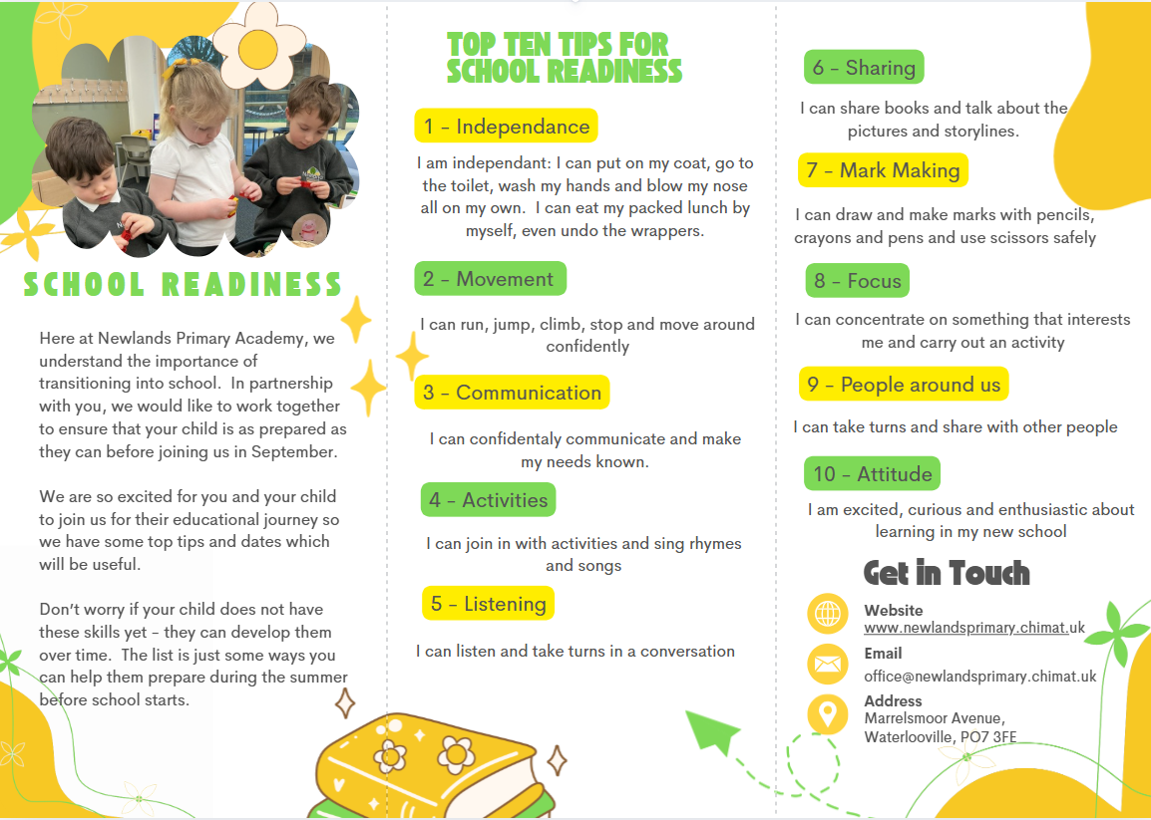
School Readiness

Slide 13
School Readiness
Please keep personal belongings at home, as items brought into school may become lost or damaged
Children should bring water only, in a clearly named bottle
Please ensure all items are named, including uniform
If your child is having a school dinner, please talk through the school menu together each day so they know what to expect
Please send your child to school with named wellington boots
Your child should bring their book bag to school every day

Slide 14
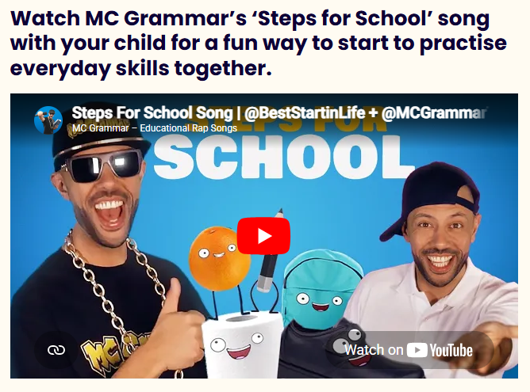
School Readiness
https://beststartinlife.gov.uk/preparing-for-school

Slide 15
Helping your children settle
Stay positive
Develop consistent routines
Arrive to school on time
Have a goodbye routine
Talk about starting school/ share a story

Slide 16
Communication
In the morning you will be greeted at Butterflies class door by Miss Moore or another member of the EYFS team. If you need to speak to us for any reason, please take this opportunity to do so. Other forms of communication:
Email: office@newlandsprimary.chimat.uk
Telephone: 02393 267 500
Tapestry: Online learning journey
Weekly Bulletin sent out via email every Friday

Slide 17

Uniform and equipment

Slide 18

Wraparound care and clubs
We are delighted to be able to offer wrap around care for our families between 7:45-6:00 each day.
JC Sports Wraparound Provision
Breakfast & After School Club
At JC Sports, we’re proud to offer a safe, fun, and active wraparound care service for busy families. Our Breakfast and After School Clubs are designed to support working parents by providing a nurturing, engaging environment where children can enjoy sports, games, and creative activities before and after the school day.
Breakfast Club (Breakfast Included)
07:45 – 08:45
● £5.99 (contract)
● £6.99 (ad-hoc)
After School Club (Food Provided)
● Until 5:00pm – £10.99 (contract) | £11.99 (ad-hoc)
● Until 5:30pm – £12.99 (contract) | £13.99 (ad-hoc)
● Until 6:00pm – £14.99 (contract) | £15.99 (ad-hoc)

Slide 19

We are looking forward to your family joining us at Newlands Primary Academy.

